Slide 1
Software Design And Modeling

Slide 2
The Structure…
Teaching Scheme:
3 Hours / Week
Total Hrs. 42 Hrs
Examination Scheme:
In-Semester : 30 Marks
End-Semester: 70 Marks
Credits : 03
Prerequisites:
Problem Solving & Object Oriented Programming
Software Engineering and Project Management
Database Management System

Slide 3
Practical
414459: Computer Laboratory VIII
Teaching Scheme: Practical:04 Hours/Week
Credits:02
Examination Scheme: TW:50 Marks
OR: 50 Marks
Prerequisites:
1. Problem Solving & Object-Oriented Programming.
2. Software Engineering and Project Management.

Slide 4
Course Objectives
To teach the student the fundamental aspects of different object oriented methodologies and Unified Approach along with Unified Modeling Language (UML), in terms of “how to use” it for the purpose of specifying and developing software.
Explore and analyze use case modeling, domain / class modeling.
To teach the student Interaction and behavior modeling.
Aware students with design process in software development.
Orient students with the software design principles and patterns.
Enable students to learn the architectural design guidelines in various type of application development.

Slide 5
Course Outcomes
By the end of the course, students should be able to
Understand object oriented methodologies, basics of Unified Modeling Language (UML).
Understand analysis process, use case modeling, domain/class modeling
Understand interaction and behavior modeling.
Understand design process and business, access and view layer class design
Get started on study of GRASP principles and GoF design patterns.
Get started on study of architectural design principles and guidelines in the various type of application development.

Slide 6
SL-VIII-Objectives
To teach the student Unified Modeling Language (UML 2.0), in terms of “how to use” it for the purpose of specifying and developing software.
To teach the student how to identify different software artifacts at analysis and design phase.
To explore and analyze use case modeling.
To explore and analyze domain/ class modeling.
To teach the student Interaction and Behavior Modeling.
To Orient students with the software design principles and patterns.

Slide 7
SL-VIII Outcomes
By the end of the course, students should be able to
1. Draw, discuss different UML 2.0 diagrams, their concepts, notation, advanced notation, forward and reverse engineering aspects.
2. Identify different software artifacts used to develop analysis and design model from requirements.
3. Develop use case model.
4. Develop, implement analysis model and design model. 5. Develop, implement Interaction and behavior Model. 6. Implement an appropriate design pattern to solve a design problem.

Slide 8
List of Assignments
1.Write Problem Statement for System / Project
2.Prepare Use Case Model
3.Prepare Activity Model
4. Prepare Analysis Model-Class Model
5. Prepare a Design Model from Analysis Model
6. Prepare Sequence Model
7. Prepare a State Model
8. Identification and Implementation of GRASP pattern
9. Identification and Implementation of GOF pattern

Slide 9
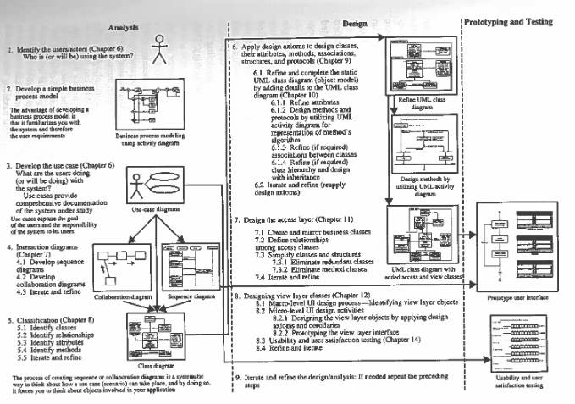
Road Map…

Slide 10
UNITS…
UNIT – I OBJECT ORIENTED METHODOLOGIES, UML
UNIT – II OBJECT ORIENTED ANALYSIS
UNIT – III INTERACTION AND BEHAVIOR MODELING
UNIT - IV OBJECT ORIENTED DESIGN
UNIT – V DESIGN PRINCIPLES AND PATTERNS
UNIT – VI ARCHITECTURAL DESIGN

Slide 11
UNITS I OBJECT ORIENTED METHODOLOGIES, UML
Topic | Reference / Text
Views of Software Developments: Traditional System Development Methodology and Object Oriented Analysis and Design, Importance Object –Orientation | Chapter 1 Object Oriented System Development by Ali Bahrami Tata McGraw Hill
Some of the object Oriented Methodology:- Object Oriented Design –Booch, Object Modeling Techniques – Rumbaugh, Object – Oriented Analysis - Cood Yourdon, Object – Oriented Software Engineering – Ivar Jacobson (Just provide Introduction to all these Approaches) | Chapter 4 Object Oriented System Development by Ali Bahrami Tata McGraw Hill
Unified Approach: Object Oriented Analysis, Object Oriented Design, Iterative Development & Continuous Testing, Modeling Based on UML, Layered Approach, | Chapter 4 Object Oriented System Development by Ali Bahrami Tata McGraw Hill

Slide 12
UNITS I OBJECT ORIENTED METHODOLOGIES, UML
Topic | Reference / Text
Unified Modeling Language: Introduction to Modeling & UML, MDA, UML Structure, UML Building Blocks, UML Common Mechanisms, 4+1 View. | Chapter 1 UML 2 and The Unified Process Practical Object Oriented Analysis and Design By Jim Arlow Ila Neustadt Pearson
Introduction to all UML Diagram Notational Techniques, (Here just give introduction all UML Diagram and syntax used in UML) | Chapter 5 Object Oriented System Development by Ali Bahrami Tata McGraw Hill

Slide 13
UNITS II OBJECT ORIENTED ANALYSIS
Topic | Reference / Text
Object Oriented Analysis Process, | Chapter 6 Object Oriented System Development by Ali Bahrami Tata McGraw Hill
Use Case Modeling: Actor Identification, Actor Classification, Actor Generalization, Use Cases Identification, Communication, Uses/Include and Extend Associations,
Writing a Formal Use Cases | Chapter 6 Software Engineering A Practitioner Approach (7e) by Roger S. Pressman McGraw Hill
Use Case realizations. | Chapter 12 UML 2 and The Unified Process Practical Object Oriented Analysis and Design By Jim Arlow Ila Neustadt (Pearson)

Slide 14
UNITS II OBJECT ORIENTED ANALYSIS
Topic | Reference / Text
Domain / Class Modeling: Approaches For Identifying Classes (Noun-Phase Approach, Common Class Pattern Approach, Class Responsibilities Collaboration Approach), Naming Classes, | Chapter 7 Object Oriented System Development by Ali Bahrami Tata McGraw Hill
Class Associations and Identification of Associations, Generalization/Specialization Relationship, Aggregation and Composition Relationships, Attributes and Methods Identification. | Chapter 8 Object Oriented System Development by Ali Bahrami Tata McGraw Hill

Slide 15
UNITS III INTERACTION AND BEHAVIOR MODELING
Topic | Reference / Text
Activity Diagram : Activity and Actions, Initial and Final Activity, Activity Edge, Decision and Merge Points, Fork and Join, Input and Output Pins, Activity Group, Activity Partitions, Constraints on Action, Swim Lanes. | Chapter 13 UML 2 Bible By Tom Pender
Sequence Diagram: Context, Objects and Roles, Links, Object Life Line, Message or stimulus, Activation/Focus of Control, Modeling Interactions. Collaboration Diagram: Objects and Links, Messages and stimuli, Active Objects, Communication Diagram, Iteration Expression, Parallel Execution, Guard Expression, Timing Diagram. | Chapter 9 UML 2 Bible By Tom Pender

Slide 16
UNITS III INTERACTION AND BEHAVIOR MODELING
Topic | Reference / Text
State Diagram: State Machine, Triggers and Ports, Transitions, Initial and Final State, Composite States, Submachine States. | Chapter 11 UML 2 Bible By Tom Pender

Slide 17
UNITS IV OBJECT ORIENTED DESIGN
Topic | Reference / Text
Object Oriented Design Process | Chapter 9 Object Oriented System Development by Ali Bahrami Tata McGraw Hill
Designing Business Layer : Object Oriented Constraints Language (OCL), Designing Business Classes : The Process, Designing Well Defined Class Visibility, Attribute Refinement, Method Design Using UML Activity Diagram, Packaging and Managing Classes. | Chapter 10 Object Oriented System Development by Ali Bahrami Tata McGraw Hill

Slide 18
UNITS IV OBJECT ORIENTED DESIGN
Topic | Reference / Text
Designing Access Layer: Object Relational Systems, Object Relation Mapping, Table Class Mapping, Table – Inherited Classes Mapping, Designing the Access Layer Classes: The Process, | Chapter 11 Object Oriented System Development by Ali Bahrami Tata McGraw Hill Or Chapter 15 Software Modeling and Design by Hassan Gomaa
Designing View Layer: View Layer Classes Design, Identifying View Classes by Analyzing Use Cases, Macro-Level Design Process, and Prototyping the User Interface. | Chapter 12 Object Oriented System Development by Ali Bahrami Tata McGraw Hill
Component and Deployment Design using Component and Deployment Diagram. | Chapter 15 and 17 UML 2 Bible By Tom Pender

Slide 19
UNITS V DESIGN PRINCIPLES AND PATTERNS
Topic | Reference / Text
Introduction to Patterns | Chapter 4 Object Oriented System Development by Ali Bahrami Tata McGraw Hill
General Responsibility Assignment Software Patterns (GRASP) : Introduction, Creator , Information Expert, Low coupling, Controller, High Cohesion, Polymorphism , Pure fabrication, Indirection, Protected Variations. | Chapter 17 and 25 Applying UML and Pattern (3e) Craig Larman Pearson Education
Gang of Four (GoF): Introduction, Categories of Patterns (Creational, Structural and Behavioral Patterns), Singleton, Adapter, State, and Strategy. | Chapter 1 ,3,4 & 5 Design Patterns by Erich Gamma Richard Helm Ralph Jonson John Vlissides

Slide 20
UNITS VI ARCHITECTURAL DESIGN
Topic | Reference / Text
Overview of software Architecture | Chapter 12 Software Modeling and Design by Hassan Gomaa
Designing Client / Server Software Architectures | Chapter 15 Software Modeling and Design by Hassan Gomaa
Designing Service Oriented Software Architectures | Chapter 16 Software Modeling and Design by Hassan Gomaa

Slide 21
UNITS VI ARCHITECTURAL DESIGN
Topic | Reference / Text
Designing Component Based Software Architectures | Chapter 17 Software Modeling and Design by Hassan Gomaa
Designing Concurrent and Real-Time Software Architectures | Chapter 18 Software Modeling and Design by Hassan Gomaa
Designing Product Line Architectures | Chapter 19 Software Modeling and Design by Hassan Gomaa

Slide 22
Text Books & Reference Books
Text Books
Ali Bahrami, Object Oriented System Development: Using Unified Modeling Language, McGraw-Hill, International Editions 1999,ISBN:0-07-116090-6.
Craig Larman, Applying UML and Patterns, Pearson Education, Second Edition,ISBN:978-0130925695.
Erich Gamma et al, Design Patterns: Elements of Reusable Object, Pearson, First Edition,ISBN:9789332555402, 9332555400.
Reference Books
Martin Fowler, UML Distilled, Pearson, Third Edition, ISBN:978-81-317-1565-9
Dan Pilone, Neil Pitman, UML in Nutshell, O’reilly Pub.,ISBN:8184040024,
9788184040029.
Roger S. Pressman, Software Engineering: A Practitioner’s Approach, McGraw Hill, Seventh Edition,ISBN: 9339212088, 9789339212087.
Hassan Gomaa, Software Modeling And Design UML, Use Cases, Pattern, & Software Architectures, Cambridge University Press, ISBN: 978-0-521-76414-8.
JIM Arlow, Ila Neustadt, UML 2 and the Unified Process, Pearson, Second Edition, ISBN: 9788131700549
Tom Pender, UML 2 Bible, Wiley India, ISBN: 9788126504527.

Slide 23
Unit-I Object Oriented Methodologies, UML

Slide 24
What is Software?
Software is the term associated with the programs that are written to manage the various resources of a computer system and perform certain designated useful tasks.

Slide 25
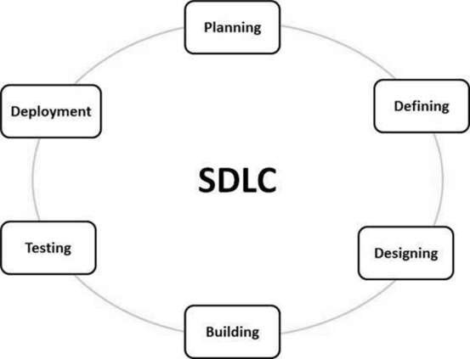

Slide 26
What is software design?
Software design is the process of defining software methods, functions, objects, and the overall structure and interaction of your code so that the resulting functionality will satisfy your users requirements

Slide 27
Software development
Analysis
Modeling
Design
Implementation
Testing
Maintenance

Slide 28
What is software modeling?
A model is an abstract representation of a system, constructed to understand the system prior to building or modifying it.
Software modeling should address the entire software design including interfaces, interactions with other software, and all the software methods.

Slide 29
What is Model?
Reduced version of system.
Removes irrelevant details of the system.
Helps detect errors and omissions in requirements, before committing the resources.
Helps communicate with the stake holders [Clients, Users, Implementers, Testers].
Helps implementation

Slide 30
Characteristics of Models
Abstract
Understandable
Accurate
Predictive
Inexpensive

Slide 31
Why Modeling ?
Testing a physical entities before building it.
Communication with customers.
Visualization.
Reduction of complexity.

Slide 32
Why Object oriented?
1.Higher level abstraction
2.Focus on data
3.Encouragment of good programming techniques
4.Reuse code

Slide 33
Object Oriented Methodologies
OMT-Rumbaugh
Object Oriented design-Booch
Object Oriented Analysis-Cood Yourdon
OOSE-Jacobson

Slide 34
OMT-Rumbaugh
Describe methods for:
-Analysis
-Design
-Implementation

Slide 35
Four phases in OMT-Rumbaugh
-Analysis
-System Design
-Object Design
-Implementation

Slide 36
OMT
Three parts
-Object model
-data dictionary
-dynamic model
-state diagram
-functional model
-Data flow

Slide 37
Object Oriented design-Booch
Describe methods for:
-Analysis
-Design
-large set of symbols

Slide 38
Booch methodology
Two development process:
1.Macro
2.Micro

Slide 39
Macro development process:
-Conceptualization
-Analysis and development of model
-Design the system architecture
-Implantation
-maintenance

Slide 40
Micro development process:
-Identify class and object
-Identify semantics of class and object
-class and object relationship
-interface of class and object

Slide 41
Object Oriented Analysis-Cood Yourdon
-Analysis phase
-Implementation phase
-Testing

Slide 42
The Jacobson Methodologies
-1.Object oriented Business Engineering
(OOBE)
-- enterprise level development
2.Object oriented Software Engineering
(OOSE)
-ood at large real time system
--Use case driven design

Slide 43
Three Models
Class Model
It describes the static structure of the objects in the system and their relationships
State Model
It describes the aspects of an object that change over time.
Interaction Model
It describes how the objects in the system co-operate to achieve broader results.

Slide 44
Unified Approach
The main motivation here is to combine the best practices, processes, methodologies, and guidelines along with UML notations and diagrams for better understanding of object-oriented concepts and system development.

Slide 45
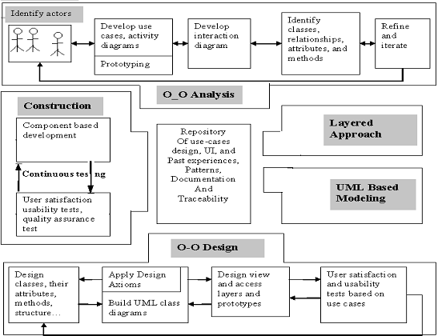

Slide 46
The unified approach to software development revolves around to the following processes and concepts. The processes are:
1. Use-case driven development
2. Object-oriented analysis
3. Object-oriented design
4. Incremental development and prototyping
5. Continuous testing

Slide 47
Technology and Methods
-UML
-layered architecture
-repository for OO pattern and framework
-Component based development

Slide 48
Object-Oriented Analysis
OOA process consists of the following steps:
1. Identify the Actors.
2. Develop a simple business process model
using UML Activity diagram.
3. Develop the Use Case.
4. Develop interaction diagrams.
5. Identify classes.

Slide 49
Object-Oriented Design
OOD Process consists of:
1. Designing classes, their attributes, methods, associations, structures and protocols, apply design axioms.
2. Design the Access Layer
3. Design and prototype User interface
4. User Satisfaction and Usability Tests based on the Usage/Use Cases
5. Iterated and refine the design

Slide 50
-Iterative Development and Continuous Testing -Modeling based on the Unified Modeling Language: UA use UML to describe and model the analysis and design phase of system development

Slide 51
Layered Approach to Software Development:
Three layered approaches
Business Layer:
The business layer contains all the objects that represent the business.
The responsibilities of business layer are very straightforward.
“Model the objects of the business and how they interact to accomplish the business processes.”
A business model captures the static and dynamic relationships among a collection of business objects.
These objects should not be responsible for Displaying details and Data Access details.

Slide 52
View Layer / User Interface Layer:
It consists of objects with which the user interacts as well as the objects needed to manage or control the interface.
There objects are identified during the object oriented design phase.
This layer is responsible for 2 major aspects. They are, Responding to user interaction and displaying business objects.
Access Layer:
It contains objects that know how to communicate with the place where the data actually reside, whether it be a relational database, mainframe, Internet or file.
It has two major responsibilities, Translate request and Translate result.

Slide 53
Component based development
Component-based software engineering (CBSE) is an approach to software development emerged in the 1990's that relies on the reuse of entities called 'software components'.

Slide 54
Unified Modeling Language
Early forms began to appear between mid-1970 and the late 1980s
Increased from 10 to 50+ between 1989 to 1994.
Roots go back to three distinct methods
“Booch method” by Grady Booch
“Object Modeling Technique” coauthored by James Rambaugh
“Objectory” by Ivan Jacobson.

Slide 55
UML
Overview
1.A language
2.For visualizing
3.For specifying
4.Constructing
5.documenting

Slide 56
Goals of UML as stated by the designers are
-To model systems using OO concepts
-To establish an explicit coupling to conceptual as well as executable artifacts
-To address the issues of scale inherent in complex, mission-critical systems
-To create a modeling language usable by humans and machine

Slide 57
To model systems using OO concepts
Specifying the structure and behavior of a system
Visualizing a system as it is or as we want it to be
Constructing a system from the template provided by the model
Documenting the decisions made

Slide 58
State
Diagrams
State
Diagrams
Class
Diagrams
Use Case
Diagrams
Use Case
Diagrams
State
Diagrams
Use Case
Diagrams
Use Case
Diagrams
State
Diagrams
Use Case
Diagrams
Object
Diagrams
Sequence
Diagrams
Scenario
Diagrams
State
Diagrams
Scenario
Diagrams
State
Diagrams
Collaboration
Diagrams
Component
Diagrams
Models
Scenario
Diagrams
Component
Diagrams
Scenario
Diagrams
Component
Diagrams
Statechart
Diagrams
Deployment
Diagrams
Activity
Diagrams

Slide 59
Three part of system’s model
Functional model
-Use case diagram
2. Object model
-Class diagram
3.Dynamic model
-sequence, Activity, State

Slide 60
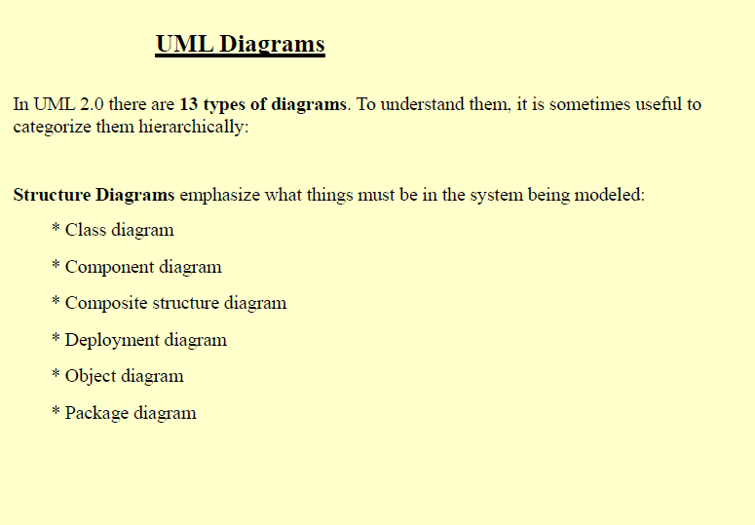

Slide 61
